Slide 1
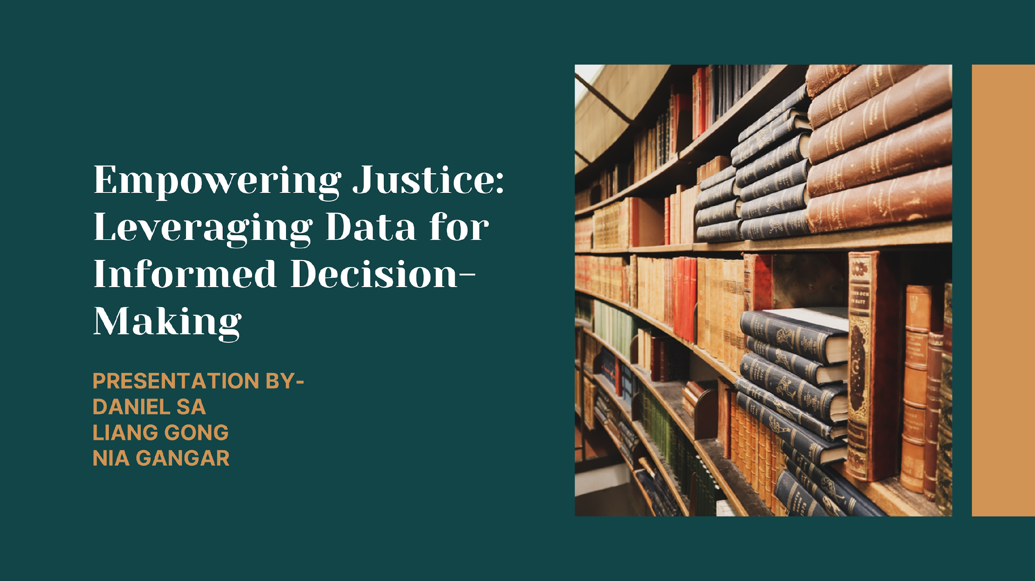

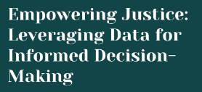
Daniel Sa Nia Gangar Liang Gong

Slide 2



Summary
A Predictive model built to refine decision-making within the justice system. By harnessing data, we’re trying to revolutionize how we approach justice, aiming for a more informed and equitable outcome.
Accuracy: ~70%
Use Cases:
Case Prioritization, Resource Allocation, Risk Assessment, Policy-Making, Crime Prevention, Sentencing Guidelines
Notes:
1.Case Prioritization: This involves using the predictive capabilities of the model to prioritize cases based on the likelihood of specific offenses. By identifying high-priority cases, law enforcement agencies can allocate their resources more efficiently, focusing their efforts where they are most needed.
2.Resource Allocation: By directing resources such as personnel, budget, and equipment to areas with higher expected crime rates or specific types of offenses, law enforcement agencies can optimize their resource allocation. This ensures that resources are utilized effectively to address the most pressing issues within the community.
3.Risk Assessment: The model assists legal professionals, such as prosecutors and defense attorneys, in evaluating the risks associated with different cases. By considering factors such as the likelihood of conviction, severity of the offense, and potential for recidivism, legal professionals can make more informed decisions regarding case strategies and potential outcomes.
4.Policy-Making: Predictive analytics can inform policy decisions related to crime prevention and justice system reforms. By analyzing trends and patterns in crime data, policymakers can identify areas where intervention is needed and develop targeted strategies to address underlying issues within the justice system.
5.Crime Prevention: The model's insights can be used to develop proactive strategies for crime prevention. By identifying emerging trends and potential hotspots, law enforcement agencies can deploy resources and interventions to deter criminal activity and improve public safety.
6.Sentencing Guidelines: Judges can use the model's predictions to make fair and informed sentencing decisions. By considering factors such as the offender's likelihood of reoffending and the severity of the offense, judges can tailor sentences that are proportionate to the crime committed while also taking into account the potential for rehabilitation.

Slide 3
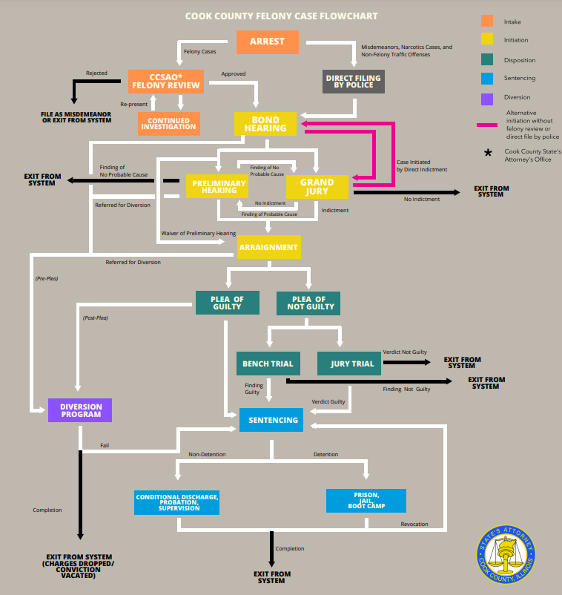
Background
and
Business Case
Notes:
The legal process is pretty complicated, and there’s a lot of ways the case can go.
We’re focusing on the Sentencing outcomes here in blue
https://www.cookcountystatesattorney.org/resources/how-read-data#Sentencing

Slide 4
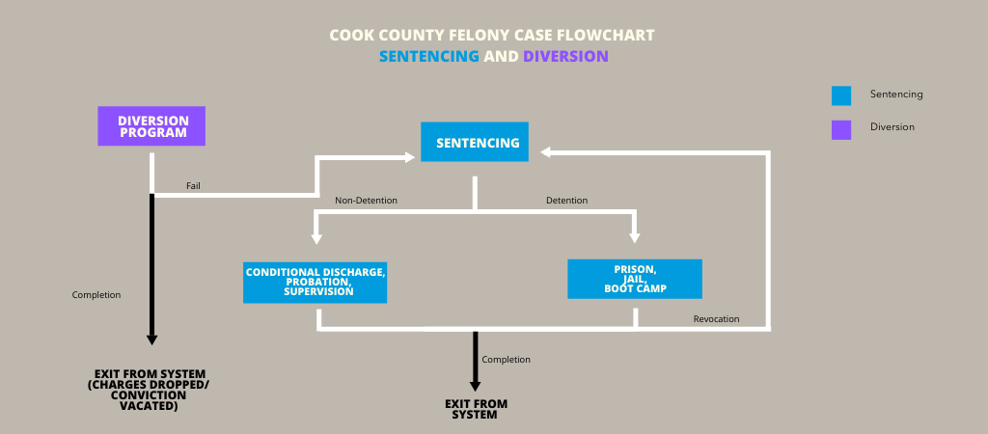
Background
and
Business Case
Non-Detention:
2nd Chance Probation
Conditional Discharge
Probation
Supervision
Detention:
Jail
Prison
Our Target
Notes:
The legal process is pretty complicated, and there’s a lot of ways the case can go.
We’re focusing on the Sentencing outcomes here in blue
https://www.cookcountystatesattorney.org/resources/how-read-data#Sentencing

Slide 5



Value Proposition
& Chosen Models
As a marketing tool & counseling tool:
A tool for enhancing legal arguments with data to appeal to the judge and jury ethos, pathos, and logos
Strategic decision making
Notes:
By using publicly available data, lawyers can let prospective clients know what their odds are like by simply predicting on the client’s features.
Lawyers can use the tool to explain the odds and reality of their case to clients in an easily comprehensible manner.
This transparency can build trust and help clients make better-informed decisions about their legal options.
On top of that, thanks to the fact that this utilizes black box models, law firms can run their own offline version of the model with their own previous clients data.
By masking that data and any PII (personally identifiable information) law firms can get an idea of where their clients results stand relative to those in the public dataset across varied legal representation (or lack thereof).
Another great feature of the models used is the feature importance.
While this isn’t as interpretable as a linear regression equation, it still gives clients and lawyers and idea of how important certain facts of the case, laws broken, client information, and others are important relative to each other.
Mitigating Bias: By relying on data-driven predictions, lawyers can help mitigate the impact of potential biases in sentencing, advocating for fairness and equity based on historical trends and patterns.
It’s no secret that there is bias in juries, and in the legal system. Not only does the model allow law firms to know where they might face it and prepare adequately, but it also allows them to use that information in their arguments to the jury, forcing them to examine their own potential biases, thus helping the legal firm’s clients.
( Credibility, Emotion, and Logic ) and to fight against bias in the court.
Lawyers and firms can more accurately prioritize their time and resources to cases as needed.

Slide 6




Chosen Models
CatBoost and LGBM
Privacy Protecting Black Boxes
But more explainable!
FAST!
Quick training times to allow for easy adoption of new datasets
Not all or Nothing!
Gives the ability to predict the probability of different outcomes, not just the most likely!
Notes:
We validated these models with at least 5 rounds of cross-validation, which basically means we know the model is generalizable.
That is, we know it’s not just suited to our data and can be applied elsewhere without issue.

Slide 7

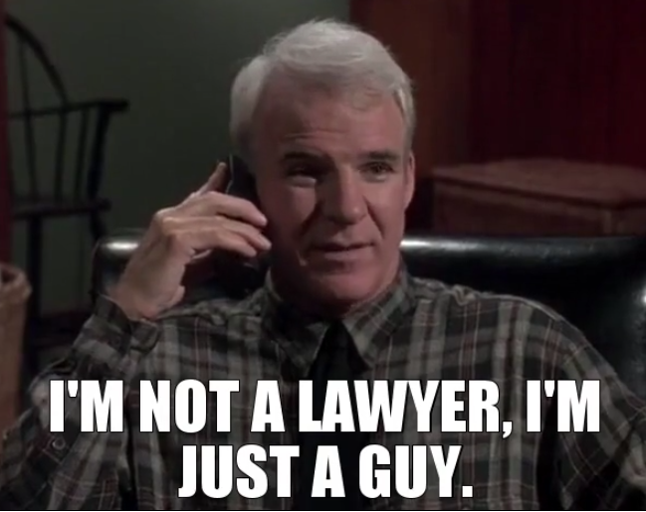
I’m not a lawyer, but…
We’re not here to replace lawyers, we’re here to help them.
This tool is only helpful in the hands of a skilled lawyer or legal team.
Notes:
What are the outcomes and predictors? I’m glad you asked. It’s at this point we feel the need to say that this tool has great potential, but is only helpful in the hands of a skilled lawyer or legal team.
If you want to predict on a new client, you’re going to need to figure out some information.
While this isn’t information tht would be easily surmisable by a layman– a good lawyer who has information from his client will be able to know what sections of the law, what charges, and how many counts of charges will be pushed on his client before officially finding them out.
What this means is the lawyer can figure out that the client is being accused of breaking Statute 27 in subsection B of chapter 2.

Slide 8



Data
Outcome Variable: The type of sentence an accused person might be subject to
Predictors:
Demographic Information (Age, Gender, Race)
Legal & Criminal Information (Legal proceedings & charges, including offense category, primary charge flag, charge count, specific charged offenses, crime types)
Incident Details (Location, the law enforcement agencies involved, dates of incident and arrest & the duration between the incident and arrest)
Notes:
Demographic Information:
Age: The age of the individual involved in the legal proceedings. It can provide insight into age-related patterns or correlations with legal outcomes.
Gender: The gender of the individual. Gender might play a role in legal proceedings due to potential biases or differences in treatment.
Race: The racial or ethnic background of the individual. Race can influence legal outcomes due to systemic biases or disparities in the justice system.
Legal & Criminal Information:
Legal Proceedings & Charges: Details about the legal proceedings, including whether the individual was charged, the types of charges, and any specific details related to the charges.
Offense Category: Categorization of the offense(s) committed, which can range from minor infractions to serious crimes.
Primary Charge Flag: Indicates whether a particular charge is considered the primary charge among multiple charges.
Charge Count: The number of charges filed against the individual.
Specific Charged Offenses: Detailed information about the specific offenses with which the individual is charged.
Crime Types: Classification of the crimes committed, which can include various categories such as violent crimes, property crimes, or drug offenses.
Incident Details:
City: The location (city) where the incident occurred. This provides geographical context and may influence legal processes.
Law Enforcement Agencies Involved: Information about the law enforcement agencies involved in handling the incident or making arrests.
Dates of Incident and Arrest: Timing details regarding when the incident occurred and when the arrest was made. This helps establish the timeline of events.
Duration Between Incident and Arrest: The time elapsed between the occurrence of the incident and the arrest. This duration may impact legal proceedings and case outcomes.

Slide 9
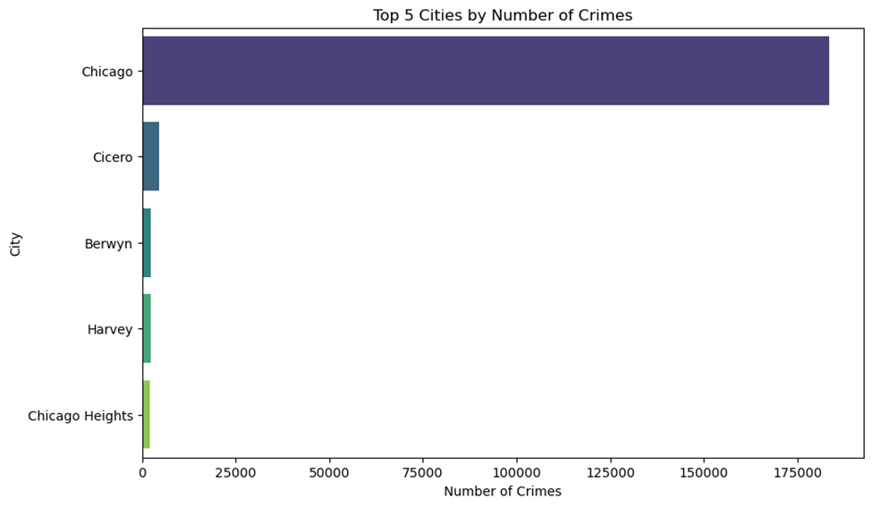
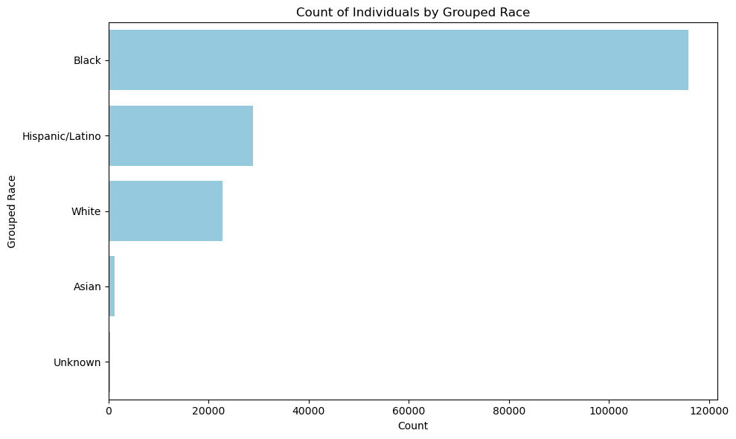
Data Limitations
Complex Legal proceedings & charges may not be fully captured by the predictors; can lead to oversimplification or misrepresentation
Predictive modeling based on historical data may not accurately predict future outcomes, if underlying factors change over time.
The dataset may not represent the entire population accurately, as it could be biased towards certain demographics. For example:
Notes:
Legal Complexity: Legal proceedings and charges can be complex and may not be fully captured by the variables provided, potentially leading to oversimplification or misrepresentation of the legal context.
Predictive Limitations: Predictive modeling based on historical data may not accurately predict future outcomes, especially if underlying patterns or factors change over time.
Sampling Bias: The dataset may not represent the entire population accurately, as it could be biased towards certain demographics or regions due to variations in law enforcement practices, reporting mechanisms, or data collection methods.

Slide 10



Feature Engineering
Calculated the number of days from the crime committed to the arrest of the accused
Simplified the ‘CRIME_TYPE’ to make the values more interpretable
Classified whether the crime was committed during daytime or night time based on the timestamp

Slide 11
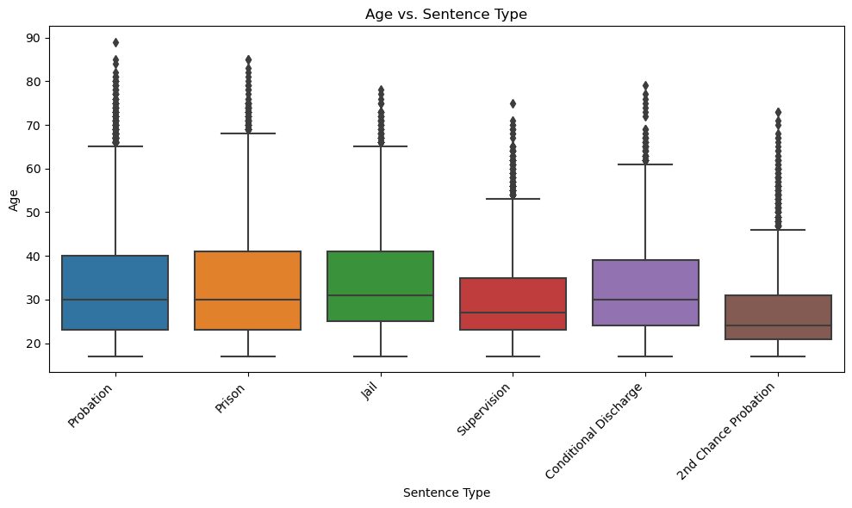
EDA

Slide 12
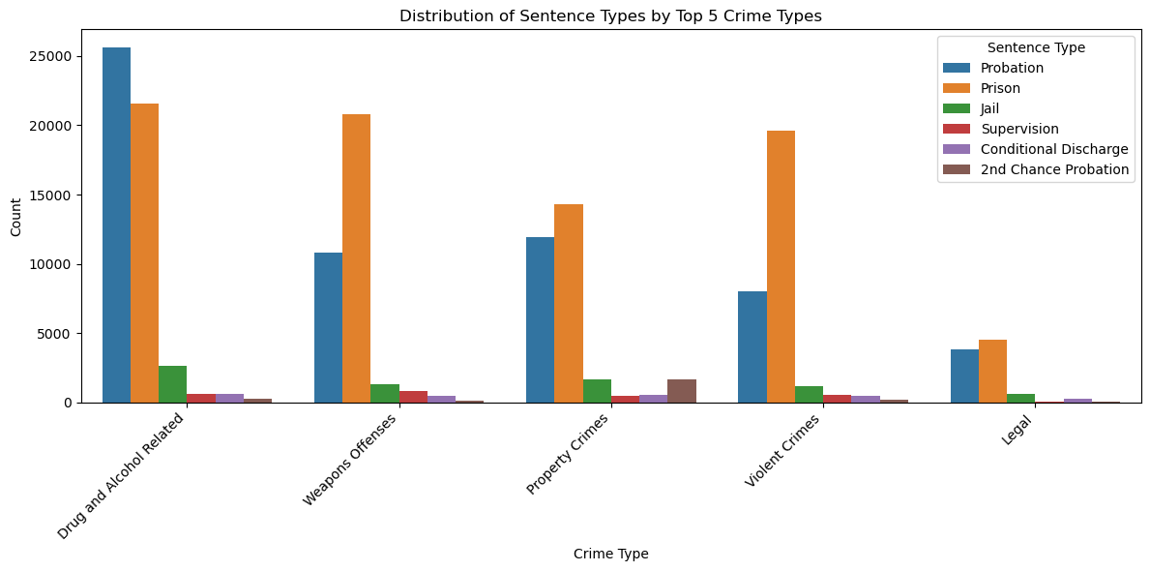

Slide 13
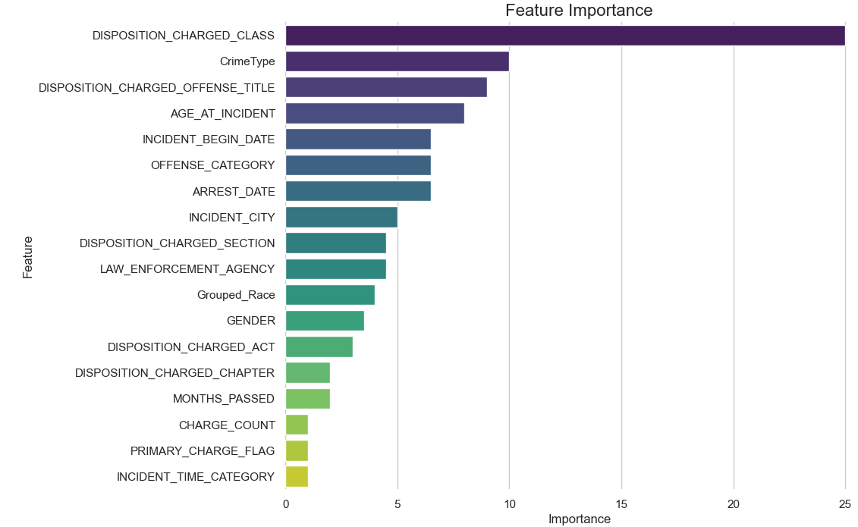
Chosen Models
CatBoostClassifier
Iterations = 200
Learning_rate = 0.3
Depth = 6
CatBoost
MinMaxScaler
OneHotEncoder
StratifiedKFold
Cross_validate
Mean CV Accuracy: 70%
Mean Recall Score: 70%
Mean Precision Score: 70%
Notes:
We validated these models with at least 5 rounds of cross-validation, which basically means we know the model is generalizable.
That is, we know it’s not just suited to our data and can be applied elsewhere without issue.
Weighted recall is equal to accuracy. 'samples' : Calculate metrics for each instance, and find their average (only meaningful for multilabel classification where this differs from accuracy_score ). Sample weights.

Slide 14
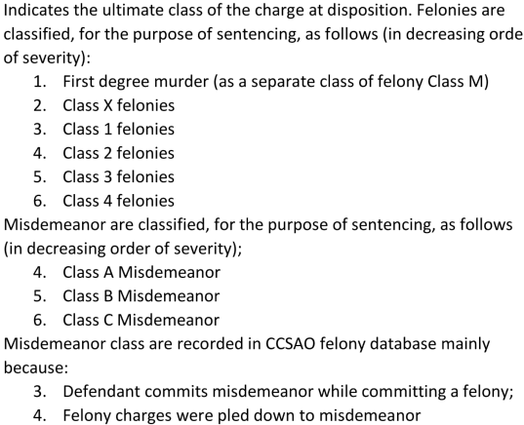
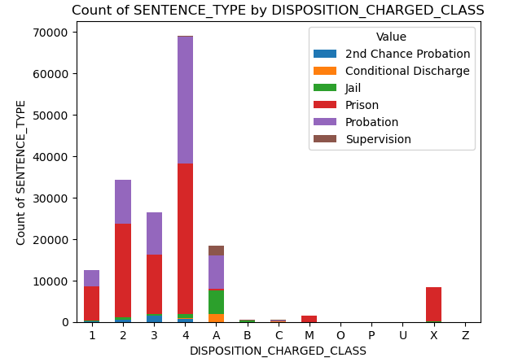
Feature Importance relates back to EDA
CatBoost
Misdemeanor barely sent defendants to prison
Notes:
We validated these models with at least 5 rounds of cross-validation, which basically means we know the model is generalizable.
That is, we know it’s not just suited to our data and can be applied elsewhere without issue.
Weighted recall is equal to accuracy. 'samples' : Calculate metrics for each instance, and find their average (only meaningful for multilabel classification where this differs from accuracy_score ). Sample weights.

Slide 15
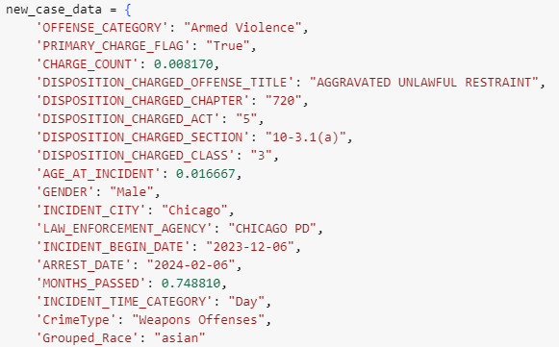
Chosen Models
CatBoost
8 charges
31 years old
2 months
Notes:
We validated these models with at least 5 rounds of cross-validation, which basically means we know the model is generalizable.
That is, we know it’s not just suited to our data and can be applied elsewhere without issue.
Weighted recall is equal to accuracy. 'samples' : Calculate metrics for each instance, and find their average (only meaningful for multilabel classification where this differs from accuracy_score ). Sample weights.

Slide 16
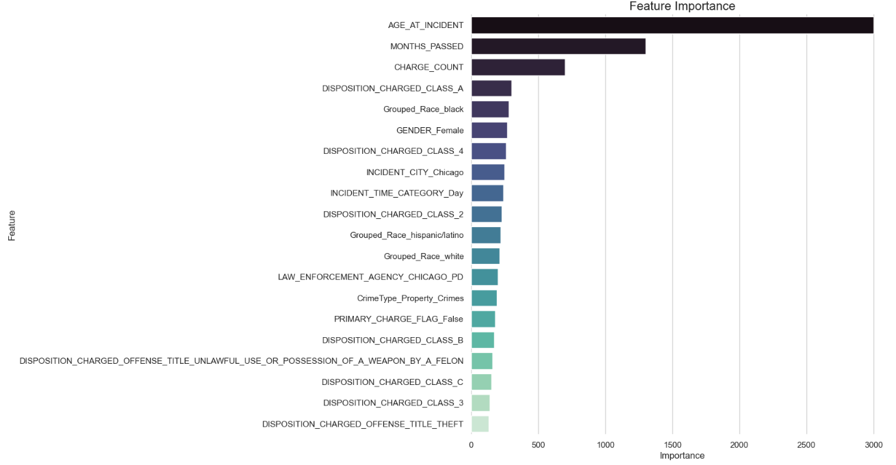
LGB Classifier
Num_leaves = 32
max_depth = -1
Learning_rate = 0.1
n_estimators = 100
Subsample = 0.8
Reg_alpha = 0.0
reg_lambda = 0.0
Chosen Models
Lightgbm
MinMaxScaler
OneHotEncoder
StratifiedKFold
cross_validate
Mean CV Accuracy: 67%
Mean Recall Score: 67%
Mean Precision Score: 66%
Notes:
We validated these models with at least 5 rounds of cross-validation, which basically means we know the model is generalizable.
That is, we know it’s not just suited to our data and can be applied elsewhere without issue.
LightGBM (Light Gradient Boosting Machine) is a gradient boosting framework developed by Microsoft that focuses on efficiency and speed. Here's a brief overview:
Gradient Boosting: LightGBM is based on the gradient boosting framework, which is an ensemble learning technique used for classification and regression tasks. It builds an ensemble of weak learners (typically decision trees) sequentially, with each new model correcting the errors of the previous ones.
Lightweight and Fast: LightGBM is designed to be highly efficient and performant. It uses a novel gradient-based algorithm and histogram-based approach to speed up the training process and reduce memory usage. This makes it particularly suitable for large-scale datasets.
Leaf-Wise Tree Growth: LightGBM adopts a leaf-wise tree growth strategy, as opposed to the traditional level-wise approach used in other gradient boosting implementations. This allows it to grow trees more efficiently by selecting the leaf with the maximum delta loss to grow in each iteration.
Gradient-Based Optimization: LightGBM uses a gradient-based optimization technique called Gradient-Based One-Side Sampling (GOSS) to reduce the computational cost of gradient calculation. It focuses more on the data points with large gradients while randomly sampling the data points with small gradients.
Histogram-Based Splitting: LightGBM employs histogram-based algorithms to find the best splits during tree construction. It discretizes continuous features into discrete bins to speed up the computation of feature histograms, making the training process faster.
Categorical Feature Support: LightGBM provides native support for categorical features without requiring one-hot encoding. It uses the "Binning of Categorical Attributes" technique to handle categorical data efficiently.
Customizable Parameters: LightGBM offers a wide range of parameters that can be tuned to optimize model performance and address overfitting. These parameters control various aspects of the training process, such as tree depth, learning rate, and regularization.
Overall, LightGBM is a powerful and efficient gradient boosting framework that is widely used for a variety of machine learning tasks, including classification, regression, and ranking. Its speed, scalability, and flexibility make it a popular choice for building high-performance predictive models.

Slide 17
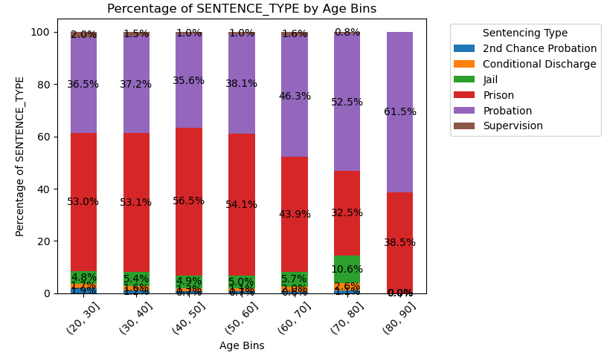
Feature Importance relates back to EDA
AGE_AT_INCIDENT:
Age of defendant at date of incident,
as recorded by law enforcement or
self-reported by defendant
Lightgbm
Older defendants are less likely to be sent to prison
Notes:
We validated these models with at least 5 rounds of cross-validation, which basically means we know the model is generalizable.
That is, we know it’s not just suited to our data and can be applied elsewhere without issue.
Weighted recall is equal to accuracy. 'samples' : Calculate metrics for each instance, and find their average (only meaningful for multilabel classification where this differs from accuracy_score ). Sample weights.

Slide 18
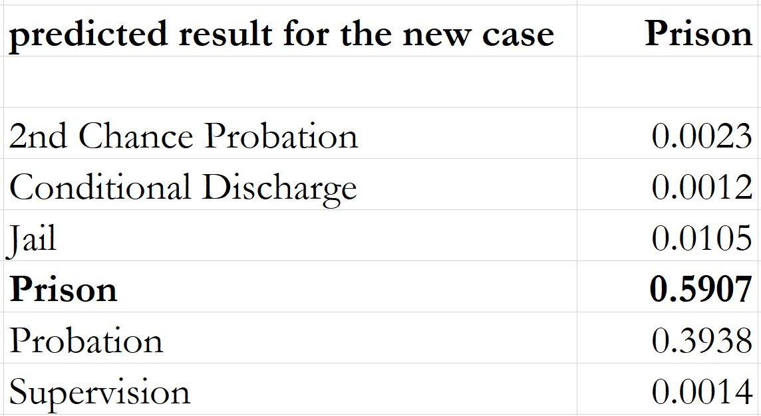
Chosen Models
lightgbm
8 charges
31 years old
2 months
Notes:
We validated these models with at least 5 rounds of cross-validation, which basically means we know the model is generalizable.
That is, we know it’s not just suited to our data and can be applied elsewhere without issue.
Weighted recall is equal to accuracy. 'samples' : Calculate metrics for each instance, and find their average (only meaningful for multilabel classification where this differs from accuracy_score ). Sample weights.

Slide 19



Future Extensions
Our feature importance results are logical
Our model is generalizable,
and customizable!
Better understanding of and use of publicly available data
Expansion of data sources
Application to more steps of the case process
Notes:
What this means is that despite a relatively low accuracy at 70%. We know the model is generalizable, scalable, and has plenty of room for improvement alongside law SMEs.
Next phase can look into predicting the commitment term.

Slide 20
Thank
You!
Notes:
What this means is that despite a relatively low accuracy at 70%. We know the model is generalizable, scalable, and has plenty of room for improvement alongside law SMEs.

Slide 21

Appendix
Notes:
1.Case Prioritization: This involves using the predictive capabilities of the model to prioritize cases based on the likelihood of specific offenses. By identifying high-priority cases, law enforcement agencies can allocate their resources more efficiently, focusing their efforts where they are most needed.
2.Resource Allocation: By directing resources such as personnel, budget, and equipment to areas with higher expected crime rates or specific types of offenses, law enforcement agencies can optimize their resource allocation. This ensures that resources are utilized effectively to address the most pressing issues within the community.
3.Risk Assessment: The model assists legal professionals, such as prosecutors and defense attorneys, in evaluating the risks associated with different cases. By considering factors such as the likelihood of conviction, severity of the offense, and potential for recidivism, legal professionals can make more informed decisions regarding case strategies and potential outcomes.
4.Policy-Making: Predictive analytics can inform policy decisions related to crime prevention and justice system reforms. By analyzing trends and patterns in crime data, policymakers can identify areas where intervention is needed and develop targeted strategies to address underlying issues within the justice system.
5.Crime Prevention: The model's insights can be used to develop proactive strategies for crime prevention. By identifying emerging trends and potential hotspots, law enforcement agencies can deploy resources and interventions to deter criminal activity and improve public safety.
6.Sentencing Guidelines: Judges can use the model's predictions to make fair and informed sentencing decisions. By considering factors such as the offender's likelihood of reoffending and the severity of the offense, judges can tailor sentences that are proportionate to the crime committed while also taking into account the potential for rehabilitation.

Slide 22
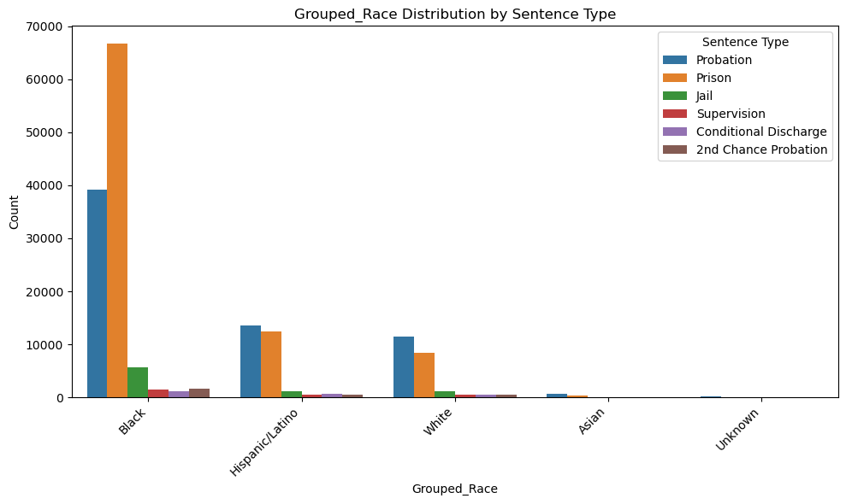

Slide 23
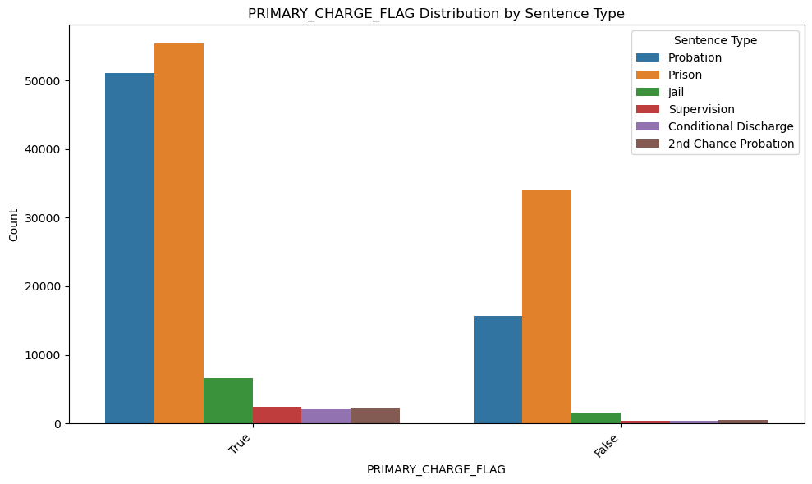

Slide 24
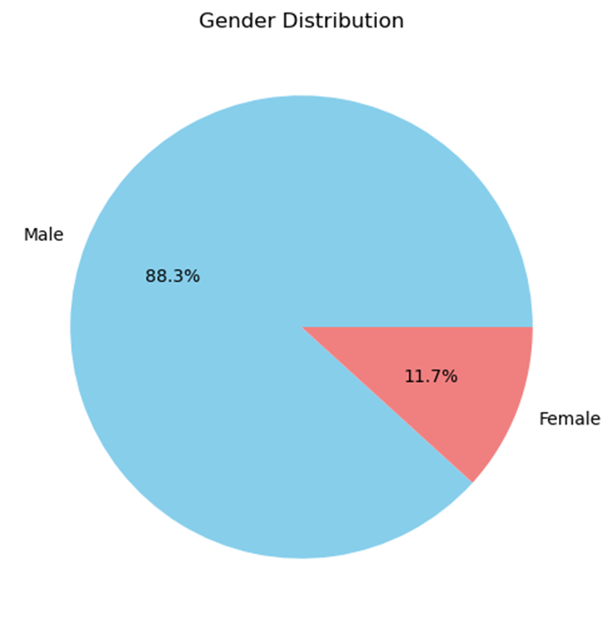
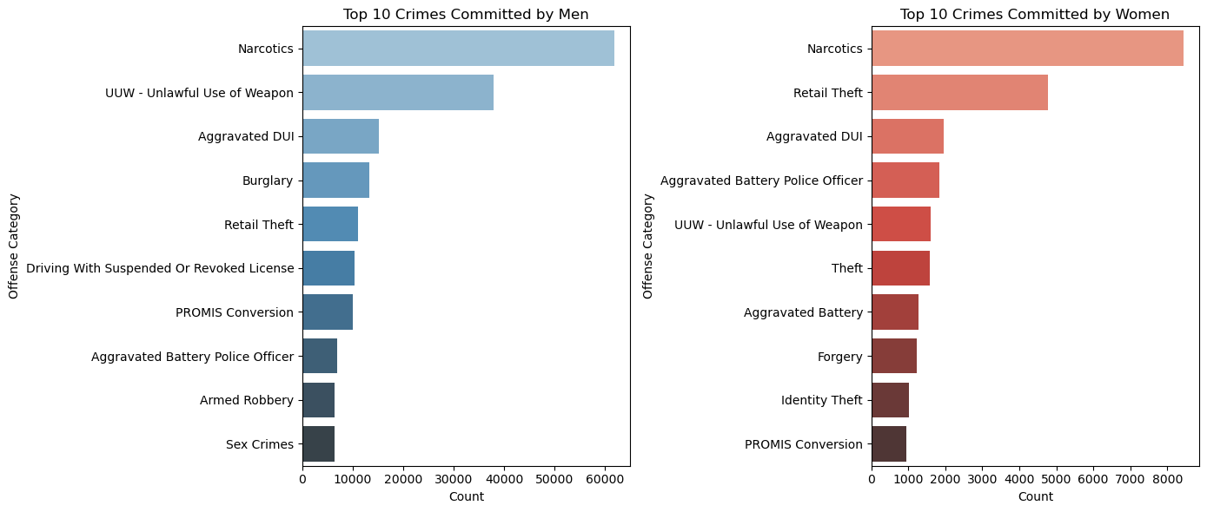
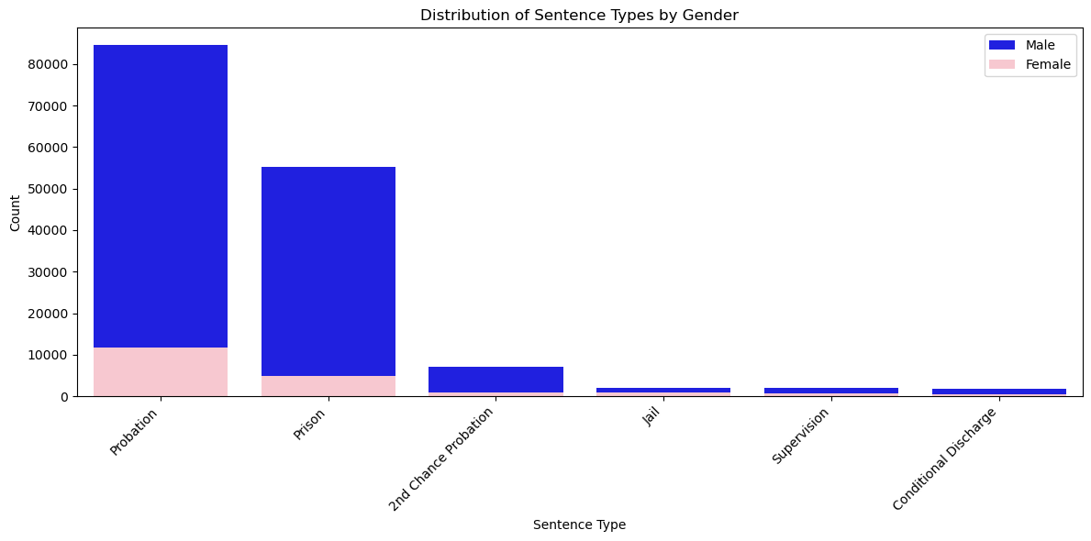
EDA

